Slide 1
IWCA Webinar:
Needs of Certain Populations
ELL Writers
Terese Thonus
Lisa Eastmond Bell
Percival Guevarra
Molly Rentscher

Slide 2
MYTHS ABOUT
MULTILINGUAL WRITERS
Terese Thonus
University of Baltimore

Slide 3
Myth #1: Multilingual students are a uniform group.
English as a foreign language
“Visa students”
World English(es)
Recent immigrants
Generation 1.5

Slide 4
Myth #2: Multilingual students are multiliterate.
Literate in L1(s)?
Or encountering literacy for the first time?
Prevalent in recent immigrants and many Gen. 1.5 students

Slide 5
Myth #3: Most multilingual writing problems are caused by writers’ L1(s).
Translation or transfer?
Similar or different categories?
The more advanced, the less transfer.
The more advanced, the fewer grammar errors and the more vocabulary errors.

Slide 6
Myth #4: Multilingual writers make the same errors in grammar and vocabulary.
Assumptions:
All languages are, at root, the same, and all differ from English.
All language learners go through the same stages.
Reality: Language learners follow different paths.

Slide 7
MYTHS ABOUT TUTORING
MULTILINGUAL WRITERS
Terese Thonus
University of Baltimore

Slide 8
Myth #1: Multilingual writers should be tutored in the same way as monolingual writers.
“One size fits all” is a cop-out.
Indirect, minimalist tutoring is often confusing.
Ask relevant questions: “How much reading have you done in English?” “What’s your strongest language for writing?”

Slide 9
Myth #2: All multilingual writers should be tutored in the same way.
Speaking and listening backgrounds differ.
Reading and writing backgrounds differ.
Play to the student’s strengths.

Slide 10
Myth #3: Tutoring is best done in English by native-speaking tutors.
Tacit knowledge of a language does not equip one to teach it.
Multilinguals can often better explain grammar and vocabulary based on their own learning experiences.
Shared L1(s) can be used for rapport-building and instruction.

Slide 11
Myth #4: Multilingual writers are concerned only with “editing,” and tutors should be able to answer their questions about grammar and vocabulary.
Assumption: Good writing = accurate writing
Denying feedback on grammar and vocabulary is unethical.
Multilingual writers do want feedback about higher-order concerns.
Imperfect feedback can still make an impact.

Slide 12
FOUNDATIONS FOR WRITING CENTER LEARNING
Lisa Eastmond Bell
Brigham Young University

Slide 13
“Learning is not something done to students”
(Ambrose, Bridges, DiPietro, Lovett, & Norman, 2010, p. 3)

Slide 14
CONSTRUCTIVIST LEARNING THEORY
CONSTRUCTIVIST LEARNING THEORY
We access knowledge and make meaning through interactions with others.
Writing, tutoring, learning as social acts
Tutoring as cognitive & affective, relational work

Slide 15
LEARNING IS COLLABORATIVE
Learning is interactive, multidirectional, participatory, experiential, and responsive
Tutors and writers and co-learners with shared goals

Slide 16
"When training tutors to work with writers, it is not enough to learn about other perspectives and people; tutors and writing center administrators need to learn with and from others."
(Bell, 2019)

Slide 17
LEARNING INVOLVES CONTEXT & BOUNDARIES
Language & literacy as contextual
Writing centers as boundary spaces
Writing center work is boundary work
Navigating & negotiating
Transfer
Critical self-reflection

Slide 18
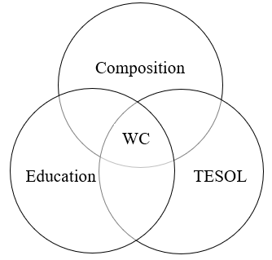
Figure 1: Illustration of the interdisciplinary nature of writing centers Adapted from “Let’s Talk!’ ESL Students’ Needs and Writing Centre Philosophy” by L. Moussu, 2013, TESL Canada Journal, 30(2), p. 65)

Slide 19
“[T]he ‘problems’ are not located in individuals but in the difficulty of moving among systems” (Grimm, 2008, p. 8).

Slide 20
TUTOR EDUCATION OBJECTIVES
Percival Guevarra
University of California, Irvine

Slide 21
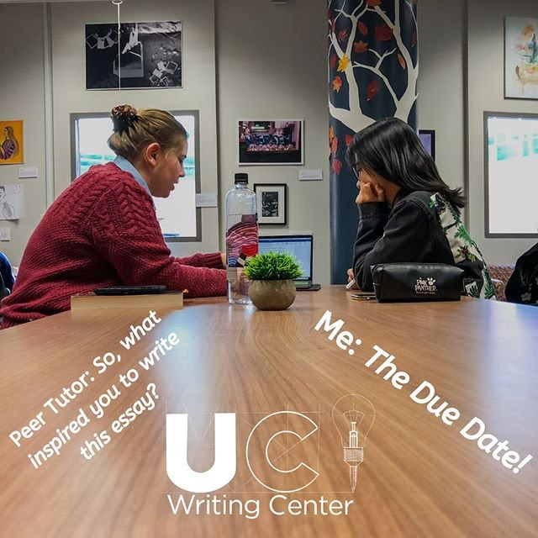
INITIATING THE SESSION
Tutors Will Be Able To (TWBAT) react positively and productively
TWBAT learn about the student's context
TWBAT set goals for the session in an appropriate manner

Slide 22
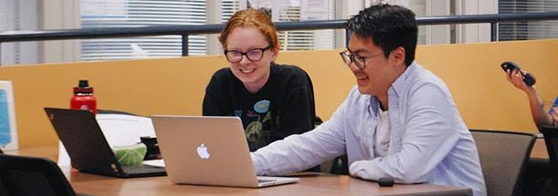
IDENTIFYING LEARNING OPPORTUNITIES
TWBAT maintain priority on improving a writer and their process
TWBAT teach skills that improve the student as a writer
(may involve co-creating or modeling a language learning process)

Slide 23
Example grammar reference card from “Working With Generation 1.5 Students and Their Teachers: ESL Meets Composition” by S. Goen, P. Porter, D. Swanson, D. VanDommelen, 2002, The CATESOL Journal, 14(1), p. 168)

Slide 24
CONCLUSIONS
Molly Rentscher
University of the Pacific

Slide 25
MULTILINGUAL WRITERS
Multilingual writers are a heterogeneous group.
Writing center administrators and tutors should understand the multilingual writers at their institutions and develop instructional and administrative practices that are sensitive to their linguistic and cultural needs. If possible, learn about multilingual writers’
writing, reading, and speaking habits;
perceived strengths and weaknesses;
composing processes;
values and beliefs; and
experiences in the writing center.

Slide 26
TUTORING MULITLINGUAL WRITERS
Develop core values: respect, empathy, and collaboration.
Explore assumptions.
Draw knowledge from multiple fields.
Prepare tutors to provide feedback on both higher-order and lower-order concerns, tailoring their approaches and feedback for each writer.

Slide 27
TUTORING MULTILINGUAL WRITERS
Affirm students’ right to their own language and prepare tutors to engage in conversations about varieties of English. A few useful principles for tutors:
Teach the dominant language forms and functions
Teach the nondominant language forms and functions
Teach the boundary between what works and what doesn’t
Teach the principles and strategies of discourse negotiation
Teach the risks involved in using deviational features (Matsuda & Matsuda, 2010, pp. 371-373)
Hire multilingual tutors and consider tutoring in other languages.

Slide 28
REFERENCES
https://tinyurl.com/iwcaELLwebinar

Slide 29
SAMPLE TRAINING ACTIVITIES

Slide 30
LANGUAGE & LITERACY AS CONTEXTUAL
Example Training

Slide 33
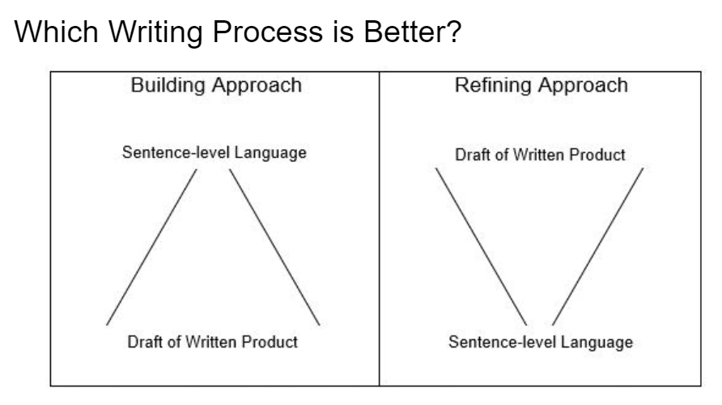

Slide 34
EXPLICIT TRAINING ON SENTENCE-LEVEL LANGUAGE
Example Training

Slide 35
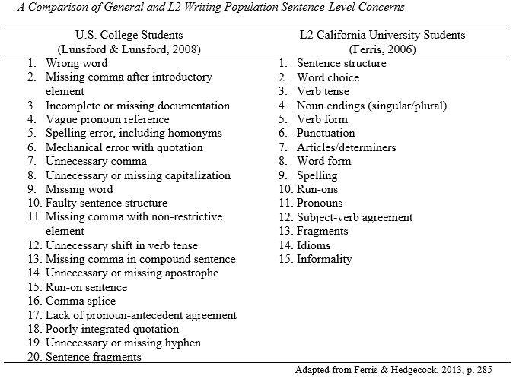

Slide 39
ACTIVITY – MAKING MEANING
Distribute garden path sentences to pairs
Model a think aloud for the first garden path sentence (describe how meaning is created / confused in your mind, rather than judging sentences)
Ask pairs to do think alouds w/ their partner for the remaining sentences (see if they can point to where in the sentence they get confused)
The correlation estimates predict growth.
Studies base value of the resource on the net price.
The complex houses research.
Scientific progress reduced feelings of disorder compared with reading articles.
Companies proposed plans continued to develop.

